Slide 1
I.T.
Buyers Guide
A Free Education Guide By: [YOUR COMPANY]
[YOUR WEBSITE]
[YOUR PHONE]
DELETE AND INSERT
YOUR LOGO HERE

Slide 2
The <<City>> << Small Business Owner’s>> Guide To I.T. Support And Services
What You Should Expect To Pay For I.T. Support For Your <<Small Business>>
(And How To Get Exactly What You Need Without Unnecessary Extras, Hidden Fees And Bloated Contracts)
Read this guide and you’ll discover:
The three most common ways I.T. services companies charge for their services, and the pros and cons of each approach.
A common billing model that puts ALL THE RISK on you, the customer, when buying I.T. services; you’ll learn what it is and why you need to avoid agreeing to it.
Exclusions, hidden fees and other “gotcha” clauses I.T. companies put in their contracts that you DON’T want to agree to.
How to make sure you know exactly what you’re getting to avoid disappointment, frustration and added costs later on that you didn’t anticipate.
21 revealing questions to ask your I.T. support firm BEFORE giving them access to your computer network, e-mail and data.
Page 2

Slide 3
From the Desk of: [YOUR NAME] [YOUR TITLE] [YOUR COMPANY] If you are the <<CEO>> of a <<business>> in <<City>> that is currently looking to outsource some or all of the I.T. support for your <<company>>, this report contains important information that will be extremely valuable to you as you search for a competent firm you can trust. My name is <<Your Name>>, <<President>> of <<Company>> and author of <<Book Title>>. We’ve been providing I.T. services to businesses in the <<City>> area for over <<X>> years. You may not have heard of us before, but I’m sure you’re familiar with one or more of the other <<niche businesses>> that are clients of ours. A few of their comments are enclosed. One of the most common questions we get from new prospective clients calling our office is “What do you guys charge for your services?” Since this is such a common question – and a very important one to address – I decided to write this report for three reasons:
1.
I wanted an easy way to answer this question and educate all prospective clients who come to us on the most common ways I.T. services companies package and price their services, and the pros and cons of each approach.
I wanted to bring to light a few “industry secrets” about I.T. services contracts and SLAs (service level agreements) that almost no <<business owner>> thinks about, understands or knows to ask about when evaluating I.T. services providers that can end up burning you with hidden fees and locking you into a long-term contract when they are unwilling or unable to deliver the quality of service you need.
I wanted to educate <<business owners>> on how to pick the right I.T. services company for their specific situation, budget and needs based on the VALUE the company can deliver, not just the price, high OR low.
2.
3.
In the end, my purpose is to help you make the most informed decision possible, so you end up working with someone who helps you solve your problems and accomplish what you want in a time frame, manner and budget that is right for you.
Dedicated to serving you,
<<Your Name>>
Page 3

Slide 4
Originally a training company founded in 1995, Computerbilities quickly turned to managed I.T. services and support in early 1996 at their customers request. Since then, Computerbilities has grown into a full-service managed I.T. services company serving small businesses and local and federal government, but with a specialty in engineering, architectural and construction firms. Computerbilities serves Raleigh, Cary, Durham, Chapel Hill and all surrounding areas.
About The Author
<<Replace copy with your own.>> Adam Pittman is President of Computerbilities, Inc., and is a veteran IT specialist and network engineer with more than 35 years of experience in the IT services industry. Adam has worked with local and federal government agencies and with more than 2,000 businesses in more than 100 industries, ranging from small start-ups to companies such as Boeing, General Dynamics and the National Institute of Environmental Health Sciences. In 2006, Adam was the recipient of the Businessman of the Year Award and received Secretary of Defense Patriotic Employer Award in 2017. Computerbilities was named Best of Raleigh Business Services in 2013. In his spare time, Adam is passionate about sailing and has sailed the British and US Virgin Islands more than a dozen times.
Delete and
Insert Headshot Here
Special Thanks To…
<<Note: You might want to collaborate with a few noncompetitive vendors to compile information on I.T. spend. For example, if you are in the medical niche, you might contact EMR companies to find out what their average customer spends for EMR software and support. In the report, give them credit for helping you and then go back and ask if they’d like you to make this available to all their clients.>>
Page 4

Slide 5
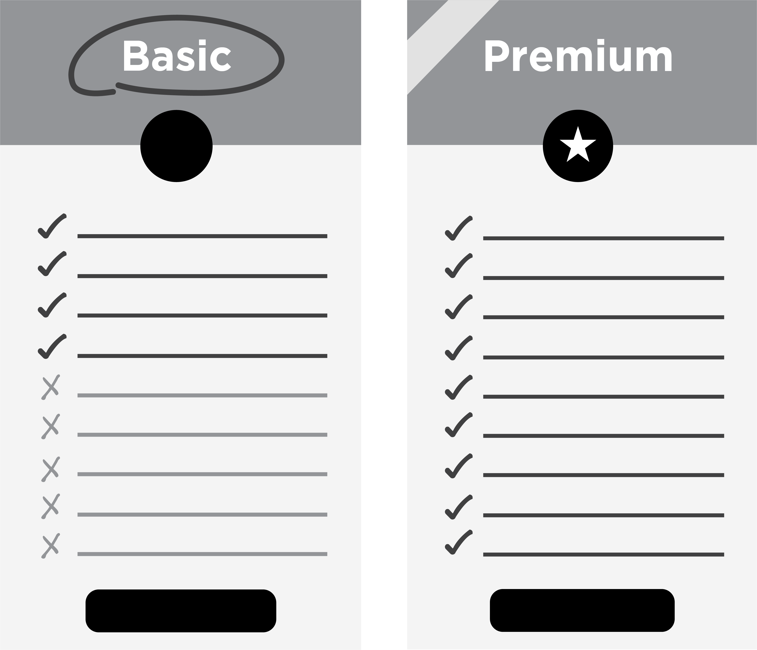
Comparing Apples To Apples: The Predominant I.T. Service Models Explained
Before you can accurately compare the fees, services and deliverables of one I.T. services company with another, you need to understand the three predominant service models most of these companies fit within. Some companies offer a blend of all three, while others are strict about offering only one service plan. The three predominant service models are:
Time and Materials. In the industry, we call this “break-fix” services. Essentially you pay an agreed-upon hourly rate for a technician to “fix” your problem when something “breaks.” Under this model, you might be able to negotiate a discount based on buying a block of hours. The scope of work may be simply to resolve a specific problem, like fixing a problem with your e-mail, or it may encompass a large project, like a network upgrade or move that has a specific result and end date clarified. Some companies will offer staff augmentation and placement under this model as well.
Managed I.T. Services. This is a model where the I.T. services company takes the role of your fully outsourced “I.T. department” and not only installs and supports all the devices and PCs that connect to your server(s), but also offers phone and on-site support, antivirus, cyber security, backup and a host of other services to monitor and maintain the health, speed, performance and security of your computer network.
Software Vendor-Supplied I.T. Services. Many software companies will offer I.T. support for their customers in the form of a help desk or remote support for an additional fee. However, these are typically scaled-back services, limited to troubleshooting their specific application and NOT your entire computer network and all the applications and devices connected to it. If your problem resides outside of their specific software or the server it’s hosted on, they can’t help you and will often refer you to “your I.T. department.” While it’s often a good idea to buy some basic-level support package with a critical software application you use to run your business, this is not enough to provide the full I.T. services and support most businesses need to stay up and running.
When looking to outsource your I.T. support, the two service models you are most likely to end up having to choose between are the “managed I.T. services” and “break-fix” models. Therefore, let’s dive into the pros and cons of these two options, and then the typical fee structure for both.
To Schedule Your FREE Assessment,
please visit www.website.com or call our office at 777-777-7777.
Page 5

Slide 6
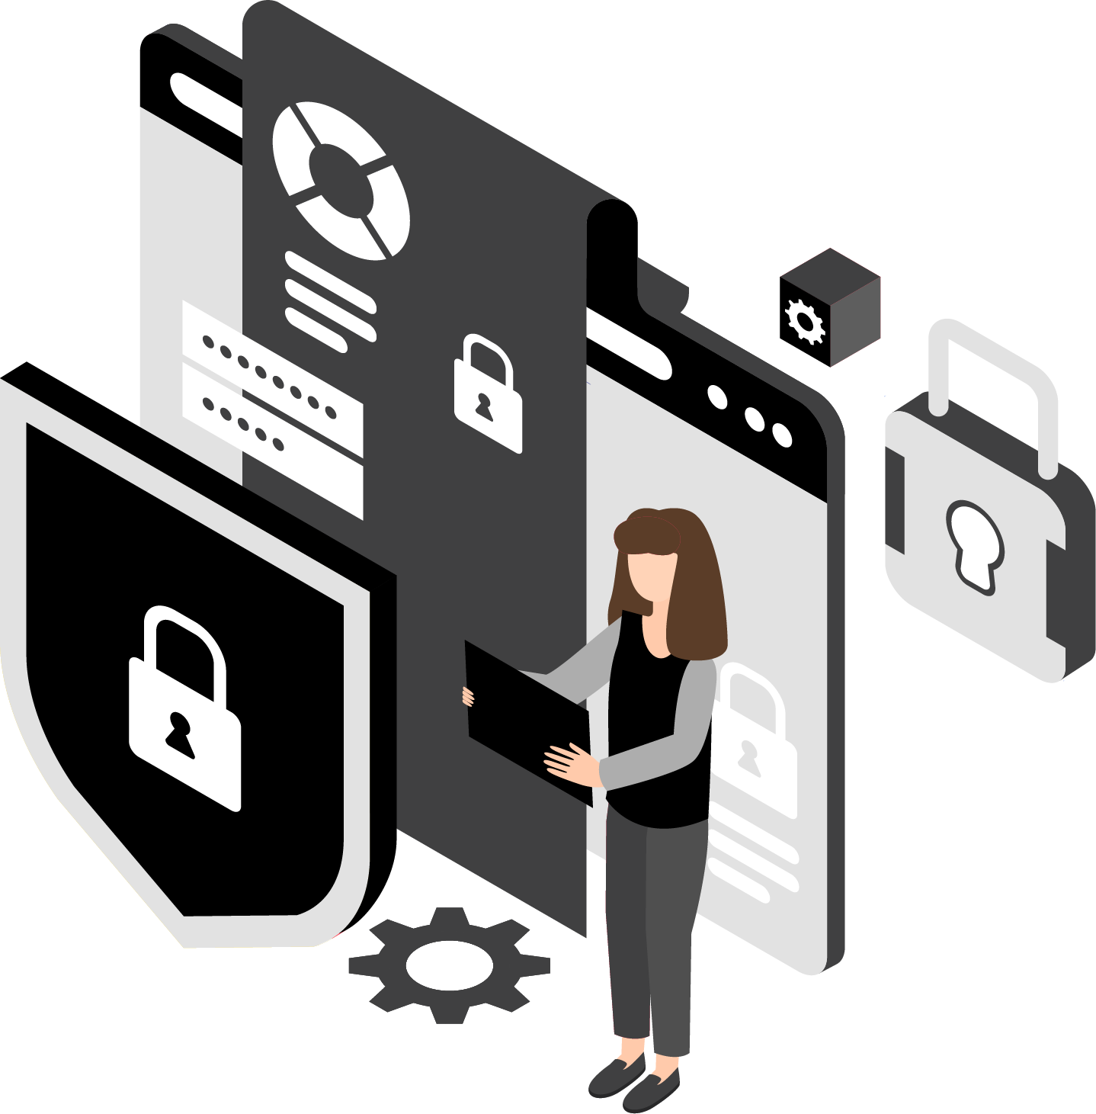
Managed I.T. Services Vs. Break-Fix: Which Is The Better, More Cost-Effective Option?
<<Note: You may want to change some or all of this depending on the argument you want to make and whether or not you feel there is a gray area. Again, consider this a “soup starter” for conveying YOUR personal point of view.>>
You’ve probably heard the famous Benjamin Franklin quote, “An ounce of prevention is worth a pound of cure.” I couldn’t agree more – and that’s why it’s my sincere belief that some form of managed I.T. is essential for every <<small business>>.
In our company, we offer different plans to fit the needs of our clients. In some cases, where the business is small, we might offer a very basic managed services plan to ensure the most essential maintenance is done, then bill the client hourly for any support used. For our smallest clients, they often find this the most economical. But for some of our midsized organizations, we offer a fully managed approach where more comprehensive I.T. services are covered in a managed plan. By doing this, we can properly staff for their accounts and ensure they get the fast, responsive support and expertise they need.
The only time I would recommend a “time and materials” approach is when you already have a competent I.T. person or team proactively managing your computer network and simply have a specific I.T. project to complete that your current in-house I.T. team doesn’t have the time nor expertise to implement (such as migrating to a cloud-based solution, implementing a cyber security plan, etc.). Outside of that specific scenario, I do not think the break-fix approach is a good idea for general I.T. support for one very important, fundamental reason: you’ll ultimately end up paying for a pound of “cure” for problems that could have easily been avoided with an “ounce” of prevention.
Why Regular Monitoring And Maintenance Is Critical For Today’s Computer Networks
The fact of the matter is computer networks absolutely, positively need ongoing maintenance and monitoring to stay secure. The ever-increasing dependency we have on I.T. systems and the data they hold – not to mention the type of data we’re now saving digitally – has given rise to very smart and sophisticated cybercrime organizations that work around the clock to do one thing: hack into your network to steal data or money or to hold you ransom.
As you may know, ransomware is at an all-time high because hackers make millions of tax-free dollars robbing one small business owner at a time. But that’s not their only incentive.
To Schedule Your FREE Assessment,
please visit www.website.com or call our office at 777-777-7777.
Page 6

Slide 7
Some will attempt to hack your network to gain access to bank accounts, credit cards or passwords to rob you (and your clients). Some use your computer network to send spam using YOUR domain and servers, host pirated software and, of course, spread viruses. Some even do it just for the “fun” of it.
And don’t think for a minute these cybercriminals are solo crooks working alone in a hoodie out of their basement. They are highly organized and well-run operations employing teams of hackers who work together to scam as many people as they can. They use advanced software that scans millions of networks for vulnerabilities and use readily available data on the dark web of YOUR usernames, passwords, e-mail addresses and other data to gain access.
Of course, this isn’t the only I.T. danger you face. Other common “disasters” include rogue employees, lost devices, hardware failures (still a BIG reason for data loss), fire and natural disasters and a host of other issues that can interrupt or outright destroy your I.T. infrastructure and the data it holds. Then there’s regulatory compliance for any business hosting or touching credit card or financial information, medical records and even client contact information, such as e-mail addresses.
Preventing these problems and keeping your systems up and running (which is what managed I.T. services is all about) is a LOT less expensive and damaging to your organization than waiting until one of these things happens and then paying for emergency I.T. services to restore your systems to working order (break-fix).
Should You Just Hire A Full-Time I.T. Manager?
In most cases, it is not cost-effective for companies with under <<100>> employees to hire a full-time I.T. person for a couple of reasons.
First of all, no one I.T. person can know everything there is to know about I.T. support and cyber security. If your company is big enough and growing fast enough to support a full-time I.T. lead, you probably need more than one guy. You need someone with help-desk expertise as well as a network engineer, a network administrator, a CIO (chief information officer) and a CISO (chief information security officer).
Therefore, even if you hire a full-time I.T. person, you may still need to supplement their position with co-managed I.T. support using an I.T. firm that can fill in the gaps and provide services and expertise they don’t have. This is not a bad plan; what IS a bad plan is hiring one person and expecting them to know it all and do it all.
Second, finding and hiring good people is difficult; finding and hiring skilled I.T. people is incredibly difficult due to the skill shortage for I.T.. And if you’re not technical, it’s going to be very difficult for you to interview candidates and sift and sort through all the duds out there to find someone with good skills and experience. Because you’re not technical, you might not know the right questions to ask during the interview process or the skills they need to do the job.
More often than not, the hard and soft costs of building an internal I.T. department for general I.T. support just don’t provide the best return on investment for the average small to midsize business. An internal I.T. department typically doesn’t make sense until you have closer to <<100>> employees OR you have unique circumstances and need specialized skills, a developer, etc., but not for day-to-day I.T. support and maintenance.
Page 7

Slide 8
Why “Break-Fix” Works Entirely In The Consultant’s Favor, Not Yours
Under a “break-fix” model, there is a fundamental conflict of interests between you and your I.T. firm. The I.T. services company has no incentive to prevent problems, stabilize your network or resolve problems quickly because they are getting paid by the hour when things stop working; therefore, the risk of unforeseen circumstances, scope creep, learning curve inefficiencies and outright incompetence are all shifted to YOU, the customer. Essentially, the more problems you have, the more they profit, which is precisely what you DON’T want.
Under this model, the I.T. consultant can take the liberty of assigning a junior (lower-paid) technician to work on your problem – one who may take two to three times as long to resolve an issue that a more senior (and more expensive) technician might resolve in a fraction of the time. There is no incentive to properly manage the time of that technician or their efficiency, and there is every reason for them to prolong the project and find MORE problems than solutions. Of course, if they’re ethical and want to keep you as a client, they should be doing everything possible to resolve your problems quickly and efficiently; however, that’s akin to putting a German shepherd in charge of watching over the ham sandwiches. Not a good idea.
Second, it creates a management problem for you, the customer, who now has to keep track of the hours they’ve worked to make sure you aren’t getting overbilled, and since you often have no way of really knowing if they’ve worked the hours they say they have, it creates a situation where you really, truly need to be able to trust they are being 100% ethical and honest AND tracking THEIR hours properly (not all do).
And finally, it makes budgeting for I.T. projects and expenses a nightmare since they may be zero one month and thousands the next.
What Should You Expect To Pay?
<<Note: You will HAVE to modify this section to fit your situation. Remember, the goal here is to highlight YOUR approach IF your pricing model and approach are far better than your competition’s. If you’re far less expensive because you are more efficient, then highlight that. If your pricing is far HIGHER than the competition’s, you need to make an argument for why that is. If your pricing is in the range of your competitors’, then you need to argue that you’re not the cheapest, but you’re not the most expensive either; however, you provide the most VALUE because X, Y and Z. Further, I recommend you give the fees for your area; Kaseya has a free, downloadable report titled “MSP Global Pricing Survey” that will give you a general idea of what other MSPs charge. But again, I would modify the fees outlined based on YOUR area and your competition.>>
Important! Please note that the following price quotes are industry averages based on a recent I.T. industry survey conducted of over 750 different I.T. services firms. We are providing this information to give you a general idea of what most I.T. services firms charge and to help you understand the VAST DIFFERENCES in service contracts that you must be aware of before signing on the dotted line. Please understand that this does NOT reflect our pricing model or approach, which is simply to understand exactly what you want to accomplish FIRST and then customize a solution based on your specific needs, budget and situation.
!
To Schedule Your FREE Assessment,
please visit www.website.com or call our office at 777-777-7777.
Page 8

Slide 9
<<NOTE: Modify this section by including any other criteria the person should look for or demand based on your professional opinion and the way you charge your clients for projects. And list all the services YOU feel a standard managed I.T. services agreement should include.>>
Hourly Break-Fix Fees:
Managed I.T. Services:
Most I.T. services companies selling break-fix services charge between <$X and $Y> per hour with a one-hour minimum. In most cases, they will give you a discount of 5% to as much as 20% on their hourly rates if you purchase and pay for a block of hours in advance.
If they are quoting a project, the fees range widely based on the scope of work outlined. If you are hiring an I.T. consulting firm for a project, I suggest you demand the following:
Most managed I.T. services firms will quote you a MONTHLY fee based on the number of devices they need to maintain, back up and support. In <<City>>, that fee is somewhere in the range of <$X to $Y> per server, <$X to $Y> per desktop and approximately <$Z> per smartphone or mobile device.
If you hire an I.T. consultant and sign up for a managed I.T. services contract, here are some things that SHOULD be included (make sure you read your contract to validate this):
A very detailed scope of work that specifies what “success” is. Make sure you detail what your expectations are in performance, workflow, costs, security, access, etc. The more detailed you can be, the better. Detailing your expectations up front will go a long way toward avoiding miscommunications and additional fees later on to give you what you REALLY wanted.
A fixed budget and time frame for completion. Agreeing to this up front aligns both your agenda and the consultant’s. Be very wary of loose estimates that allow the consulting firm to bill you for “unforeseen” circumstances. The bottom line is this: it is your I.T. consulting firm’s responsibility to be able to accurately assess your situation and quote a project based on their experience. You should not have to pick up the tab for a consultant underestimating a job or for their inefficiencies. A true professional knows how to take into consideration those contingencies and bill accordingly.
Security patches applied weekly, if not daily, for urgent and emerging threats
Antivirus updates and monitoring
Firewall updates and monitoring
Backup monitoring and test restores
Spam-filter installation and updates
Monitoring workstations and servers for signs of failure
Optimizing systems for maximum speed
Documentation of your network, software licenses, credentials, etc.
<<Add more if you know of other points>>
The following services may NOT be included and will often be billed separately. This is not necessarily a “scam” or unethical UNLESS the managed I.T. services company tries to hide these fees when selling you a service agreement. Make sure you review your contract carefully to know what is and is NOT included!
Hardware (ex. new servers), PCs, laptops, etc.
Software licenses
Special projects
<<Etc.>>
Warning! Beware the gray areas of “all-inclusive” service contracts. In order to truly compare the “cost” of one managed I.T. services contract with another, you need to make sure you fully understand what IS and ISN’T included AND the SLA (service level agreement) you are signing up for. It’s VERY easy for one I.T. services provider to appear less expensive than another UNTIL you look closely at what you’re getting.
Page 9

Slide 10
When I have an I.T. problem, how do I get support?
The following are 21 questions to ask your I.T. services provider that will clarify exactly what you’re getting for the money. Some of these items may not be that important to you, while others (like response time, adequate insurance and uptime guarantees) may be critical. Make sure you fully understand each of these items before making a decision about who the right provider is for you, then make sure you get this IN WRITING.
21 Questions You Should Ask Your
I.T. Services Company Or Consultant
Before Hiring Them For I.T. Support
<<NOTE: The questions below are simply meant to provide you with examples of what to include in this report and will be a great starting point that will save you a lot of time. However, never forget this is YOUR advice to a potential prospect, so the questions and answers should reflect your personal philosophy and abilities. You might not agree with everything outlined here and you might not be able to deliver on it – that’s fine! Remember, the key is to educate the buyer with questions they would ask your competition that would help reveal why YOU are the better choice. NEVER LIE or stretch the truth! You should complete the client research section BEFORE finishing this report; you might discover that you have to improve your services to meet the demands of your clients AND stand out from competitors.>>
Customer Service:
Q1
Our Answer: When a client has a problem, we “open a ticket” in our I.T. management system so we can properly assign, track, prioritize, document and resolve client issues. However, some I.T. firms force you to log in to submit a ticket and won’t allow you to call or e-mail them. This is for THEIR convenience, not yours. Trust me, this will become a giant inconvenience and thorn in your side. While a portal is a good option, it should never be your ONLY option for requesting support. Also, make sure they HAVE a reliable system in place to keep track of client “tickets” and requests. If they don’t, I can practically guarantee your requests will sometimes get overlooked, skipped and forgotten.
Requesting support should also be EASY for you. So be sure to ask how you can submit a problem to their support desk for resolution. We make it easy. Calling, e-mailing or submitting a ticket via our portal puts your I.T. issue on the fast track to getting resolved.
Q2
Do you offer after-hours support, and if so, what is the guaranteed response time?
Our Answer: Any good I.T. company will answer their phones LIVE (not voice mail or phone trees) and respond from 8:00 a.m. to 5:00 p.m. every weekday. But many CEOs and executives work outside normal “9 to 5” hours and need I.T. support both nights and weekends. Not only can you reach our after-hours support any time and any day, we GUARANTEE a response time of <<insert one hour or two hours>> or less for normal problems, and within <<X>> minutes for problems marked “emergency,” such as a network being down or a critical problem that is significantly impacting your ability to work.
Page 10

Slide 11
Do you have a written, guaranteed response time for working on resolving your problems?
Q3
Our Answer: Most I.T. firms offer a 60-minute or 30-minute response time to your call during normal business hours. Be very wary of someone who doesn’t have a guaranteed response time IN WRITING – that’s a sign they are too disorganized, understaffed or overwhelmed to handle your request. Our written, guaranteed response time is <<insert one hour or two hours>> or less. A good I.T. firm should also be able to show you statistics from their PSA (professional services automation) software, where all client problems (tickets) get responded to and tracked. Ask to see a report on average ticket response and resolution times.
Q4
Will I be given a dedicated account manager?
Our Answer: Smaller firms may not offer this due to staff limitations, and the owner may tell you they will personally manage your account. While that sounds like great customer service, the owner is usually so busy that you’ll only be given reactive support instead of proactive account management. Rest assured, from initial call to final resolution, you will work with our SAME dedicated account manager who will know you, your business and your goals.
Q5
Do you have a feedback system in place for your clients to provide “thumbs up” or “thumbs down” ratings on your service? If so, can I see those reports?
Our Answer: If they don’t have this type of feedback system, they may be hiding their lousy customer service results. If they DO have one, ask to see the actual scores and reporting. That will tell you a lot about the quality of service they are providing. We are very proud of our positive client feedback scores and will be happy to show them to you.
I.T. Maintenance (Managed Services):
Q6
Do you offer true managed I.T. services and support?
Our Answer: You want to find an I.T. company that will proactively monitor for problems and perform routine maintenance on your I.T. systems. If they don’t have the ability to do this, or they don’t offer it, we strongly recommend you look somewhere else. Our remote network monitoring system watches over your network to constantly look for developing problems, security issues and other problems so we can address them BEFORE they turn into bigger problems.
Page 11

Slide 12
Q7
What is NOT included in your managed
services agreement?
Our Answer: Another “gotcha” many I.T. companies fail to explain is what is NOT included in your monthly managed services agreement that will trigger an invoice. Their so-called “all you can eat” option is RARELY true – there are limitations to what’s included and you want to know what they are BEFORE you sign.
It’s very common for projects to not be included, like a server upgrade, moving offices, adding new employees and, of course, the software and hardware you need to purchase.
But here’s a question you need to ask: If you were hit with a
costly ransomware attack, would the recovery be EXTRA or
included in your contract? Recovering from a cyber-attack could
take HOURS of high-level I.T. expertise. Who is going to eat that bill? Be sure you’re clear on this before you sign, because surprising you with a big, fat bill is totally and completely unacceptable.
Other things to inquire about are:
Do you offer truly unlimited help desk? (Make sure you are not nickel-and-dimed for every call.)
Does the service include support for cloud services, such as Microsoft 365?
Do you charge extra if you have to resolve a problem with a line-of-business application, Internet service provider, phone system, leased printer, etc.? (What you want is an I.T. company that will own the problems and not point fingers. We are happy to call the vendor or software company on your behalf.)
What about on-site support calls? Or support to remote offices?
If our employees had to work remote (due to a shutdown, natural disaster, etc.), would you provide support on their home PCs or would that trigger a bill?
If we were to get ransomed or experience some other disaster (fire, flood, theft, tornado, hurricane, etc.), would rebuilding the network be included in the service plan or considered an extra project we would have to pay for? (Get this IN WRITING. Recovering from such a disaster could take hundreds of hours of time for your I.T. company’s techs, so you want to know in advance how a situation like this will be handled before it happens.)
Our managed services agreement is completely transparent and covers <<give examples of what your managed services agreement covers>>.
To Schedule Your FREE Assessment,
please visit www.website.com
or call our office at 777-777-7777.
Page 12

Slide 13
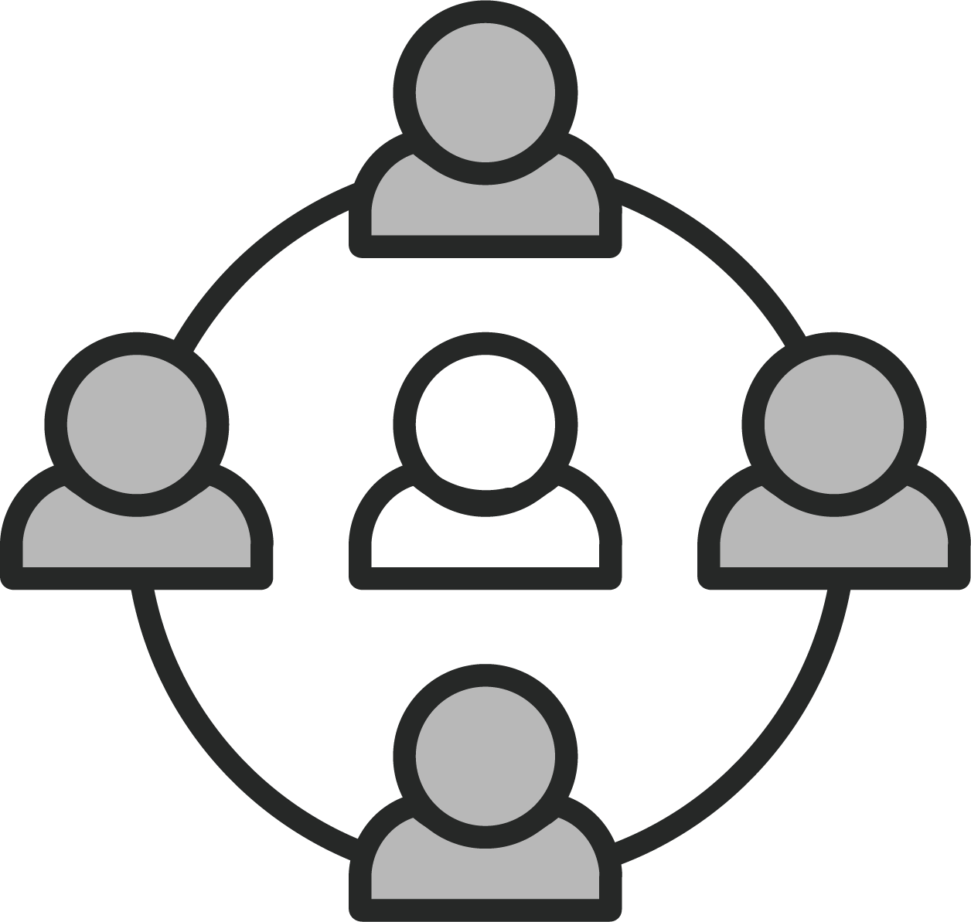
Is your help desk local or outsourced?
Q8
Our Answer: Be careful because smaller I.T. firms may outsource this critical function. As a result, you may get a tech who is not familiar with you, your network, previous problems and personal preferences. Or worse, they may not be as qualified. This can be frustrating and lead to the same problems cropping up over and over, longer resolution time and you having to spend time educating the tech on your account.
Fortunately, we provide a dedicated technician to your account who will get to know you and your company, as well as your preferences and history. When you work with our local help desk technician, they’ll be more capable of successfully resolving your I.T. issues and handling things the way you want.
Q9
How many engineers do you have on staff?
Our Answer: Be careful about hiring small, one-person I.T. firms that only have one or two techs or that outsource this critical role. Everyone gets sick, has emergencies, goes on vacation or takes a few days off from time to time. We have more than enough full-time techs on staff to cover in case one is unable to work.
ALSO: Ask how they will document fixes, changes, credentials for you organization so if one tech is out or unavailable, another can step in and know your network settings, history, previous issues, etc., and how those issues were resolved. This is important or you’ll be constantly frustrated with techs who are starting over to resolve a known issue or may screw up something because they don’t understand or have a blueprint of your computer network.
Q10
Do you offer documentation of our network as part of the plan, and how does that work?
Our Answer: Network documentation is exactly what it sounds like: the practice of maintaining detailed technical records about the assets you own (computers, devices, software, directory structure, user profiles, passwords, etc.) and how your network is set up, backed up and secured. Every I.T. company should provide this to you in both written (paper) and electronic form at no additional cost and update it on a quarterly basis.
Why is this important? There are several reasons:
First, it shows professionalism and integrity in protecting YOU. No I.T. person or company should be the only holder of the keys to the kingdom. Because we document your network assets and passwords, you have a blueprint you can give to another I.T. person or company to take over if necessary.
Second, good documentation allows the engineers working on your account to resolve problems faster because they don’t waste time fumbling their way around your network trying to find things and uncover accounts, hardware, software licenses, etc.
Page 13

Slide 14
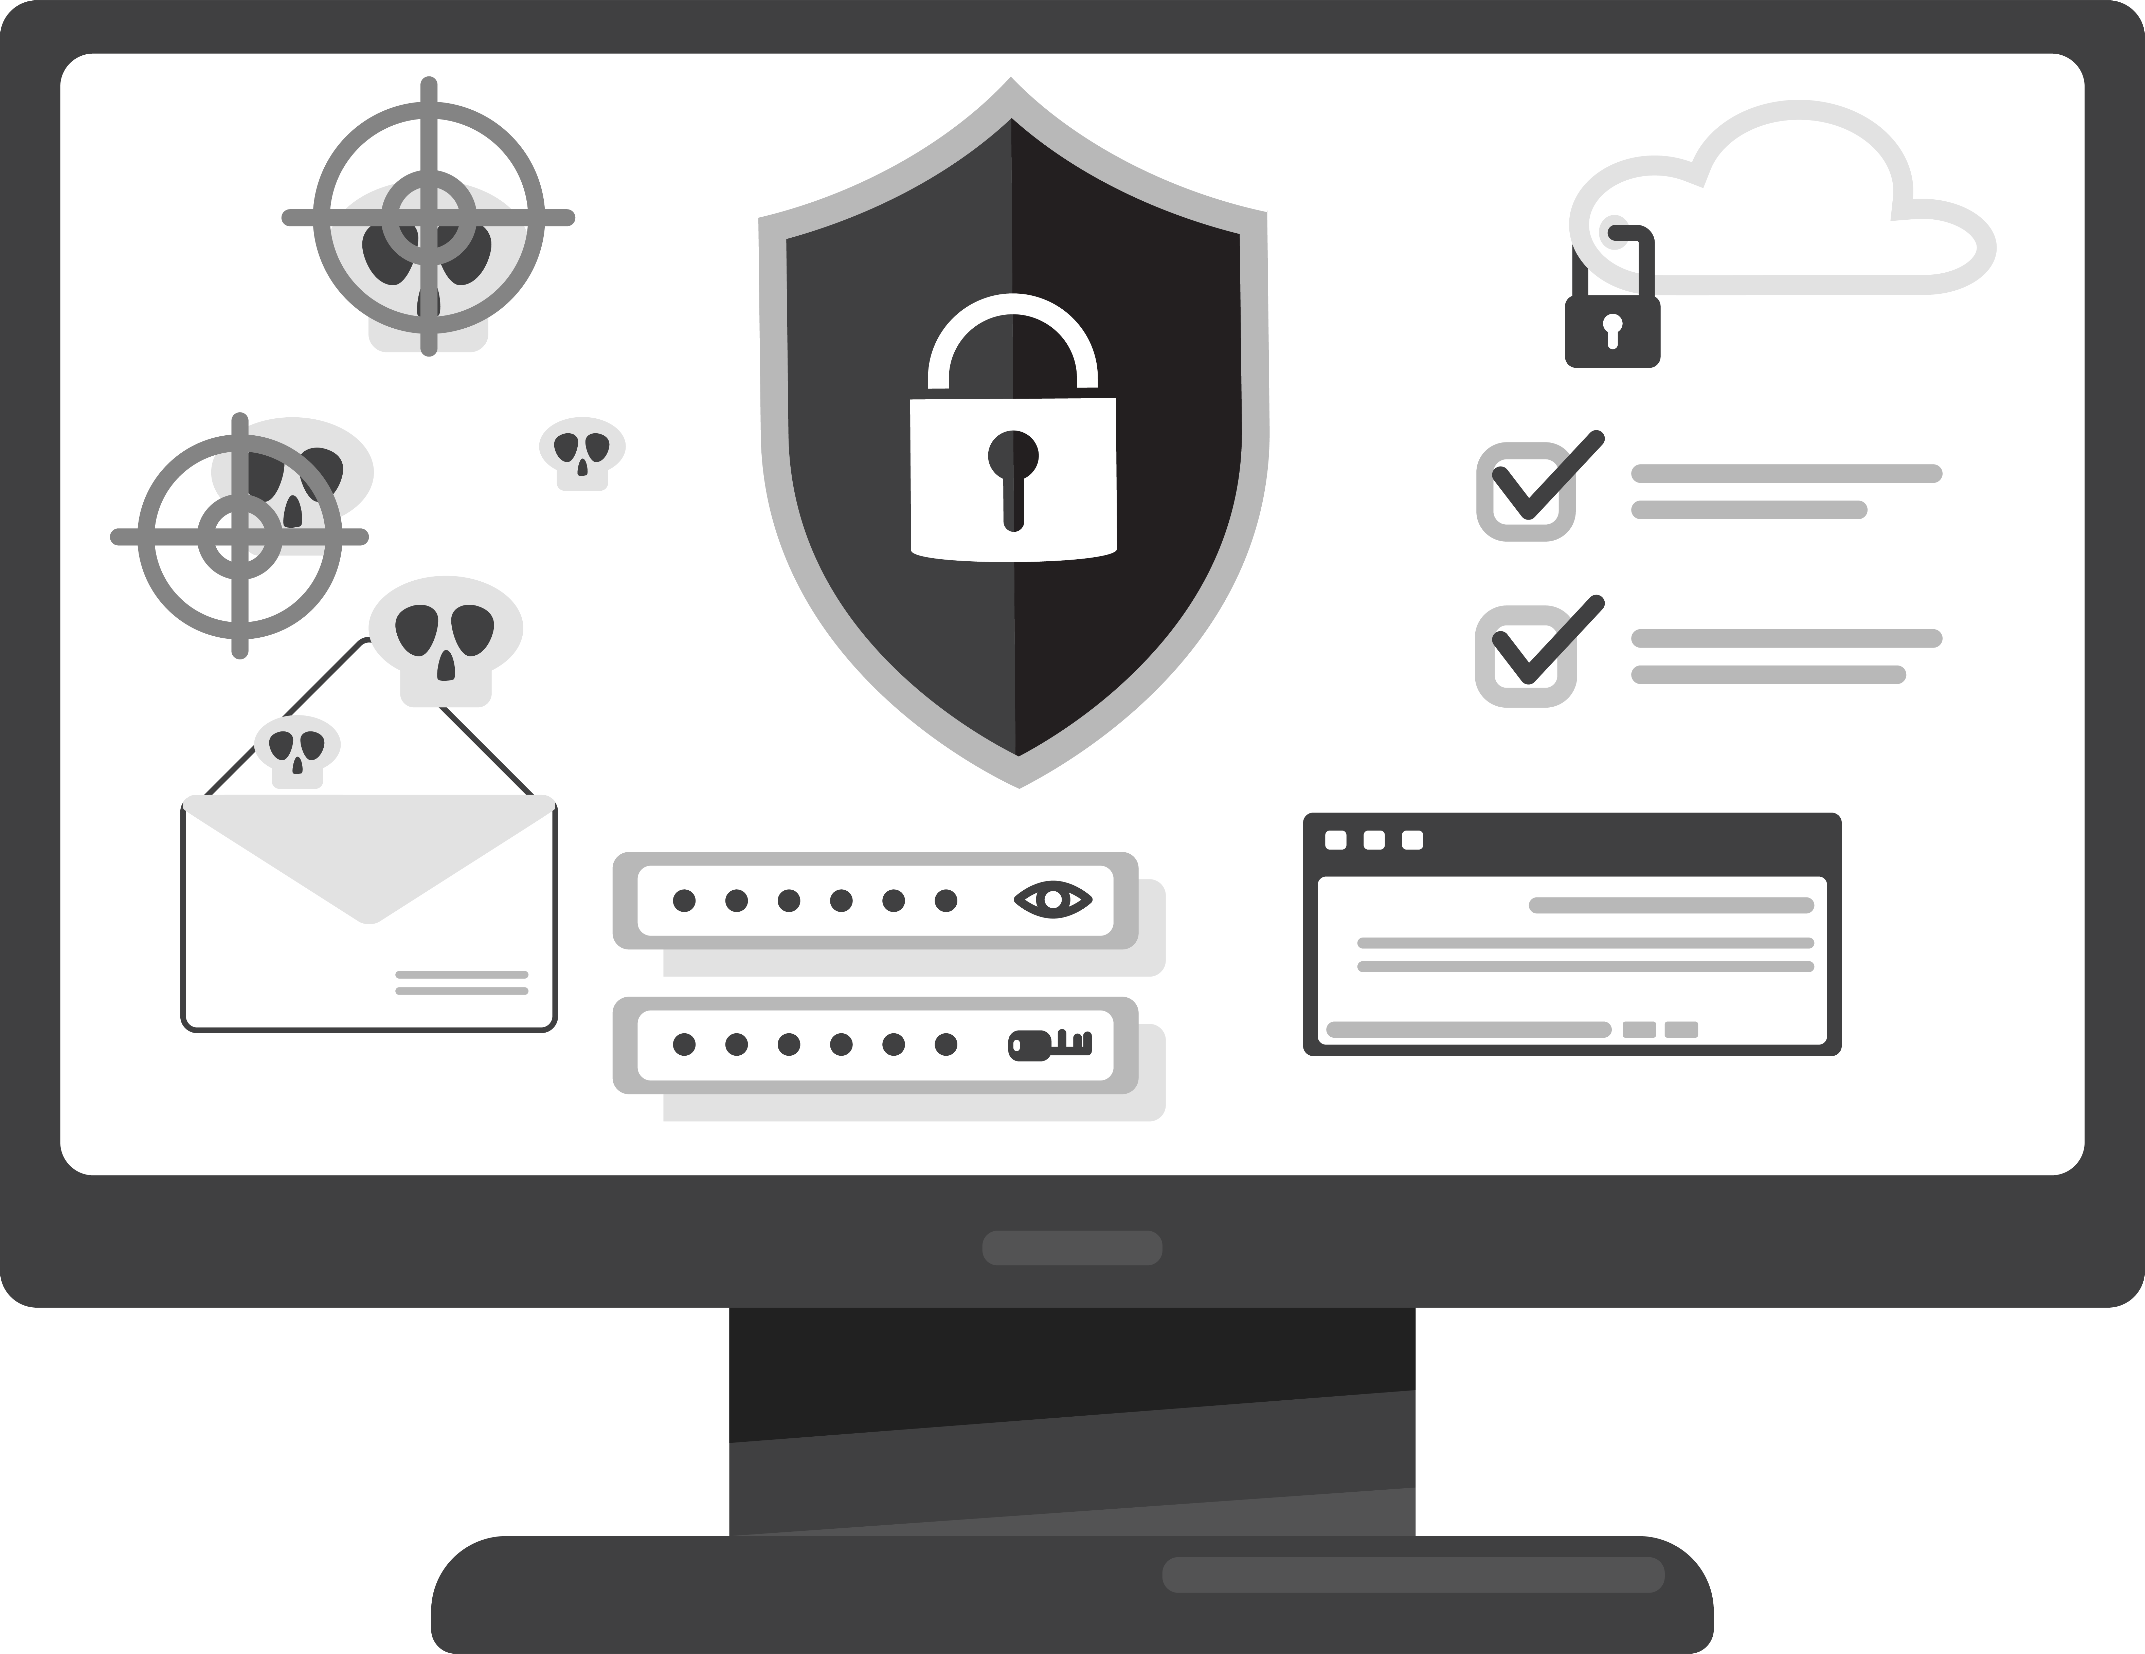
Third, if you had to restore your network after a disaster, you’d have the blueprint to quickly put things back in place as they were.
All our clients receive this in written and electronic form at no additional cost. We also perform a quarterly update on this material and make sure certain key people from your organization have this information and know how to use it, giving you complete control over your network.
Side note: You should NEVER allow an I.T. person to have that much control over you and your company. If you get the sneaking suspicion that your current I.T. person is keeping this under their control as a means of job security, get rid of them (and we can help to make sure you don’t suffer ANY ill effects). This is downright unethical and dangerous to your organization, so don’t tolerate it!
Q11
Do you meet with your clients quarterly as part of your managed services agreement?
Our Answer: To us, there’s nothing more important than face-to-face time with our clients. Therefore, we make it a priority to meet with all our clients at least quarterly (sometimes more often) to provide a “technology review.”
In these meetings, we provide you with the status updates of projects you’re working on and of the health and security of your network. We also make recommendations for new equipment and upgrades you’ll be needing soon or sometime in the near future. Our quarterly meetings with you are C-level discussions (not geek-fests) where we openly discuss your business goals, including your I.T. budget, critical projects, compliance issues, known problems and cyber security best practices.
Our goal in these meetings is to help you improve operations, lower costs, increase efficiencies and ensure your organizational productivity stays high. This is also your opportunity to give us feedback on how we’re doing and discuss upcoming projects.
Q12
If I need or want to cancel my service with you, how does this happen and how do you offboard us?
Our Answer: Make sure you carefully review the cancellation clause in your agreement. Many I.T. firms hold their clients hostage with long-term contracts that contain hefty cancellation penalties and will even sue you if you refuse to pay.
We would never “force” a client to stay with us if they are unhappy for any reason. Therefore, we make it easy to cancel your contract with us, with zero contention or fines. Our “easy out” agreements make us work that much harder to exceed your expectations every day so we keep your business.
To Schedule Your FREE Assessment,
please visit www.website.com or call our office at 777-777-7777.
Page 14

Slide 15
Cyber Security:
Q13
What cyber security certifications do you and your in-house team?
Our Answer: It’s important that your I.T. firm have some type of recent training and certifications, and they should be able to answer this question, which demonstrates a dedication to learning and keeping up with the latest cyber security protections. If they don’t have any, and they aren’t investing in ongoing training for their engineers, that’s a red flag. Some business owners won’t invest in training and give this excuse: “What if I spend all this money training my employees and then they leave us for another job?” Our response is “What if you DON’T train them and they stay?”
You can feel confident that our in-house technicians have among the most advanced cyber security training and certifications available, including <<feature your team’s current cyber security certifications and spell them out along with the acronym>>.
Q14
How do you lock down our employees’ PCs and devices to ensure they’re not compromising our network?
Our Answer: As above, the question may get a bit technical. The key is that they HAVE an answer and don’t hesitate to provide it. Some of the things they should mention are:
2FA (two-factor authentication)
Advanced end-point protection, NOT just antivirus
<<add another of your lockdown strategies here>>
<<add another of your lockdown strategies here>>
Because a combination of these lockdown strategies is essential to protecting your network and data, we employ ALL of these for our clients. Effective cyber security should never compromise between choosing this OR that. It should feature every weapon in your arsenal.
To Schedule Your FREE Assessment,
please visit www.website.com
or call our office at 777-777-7777.
Page 15

Slide 16
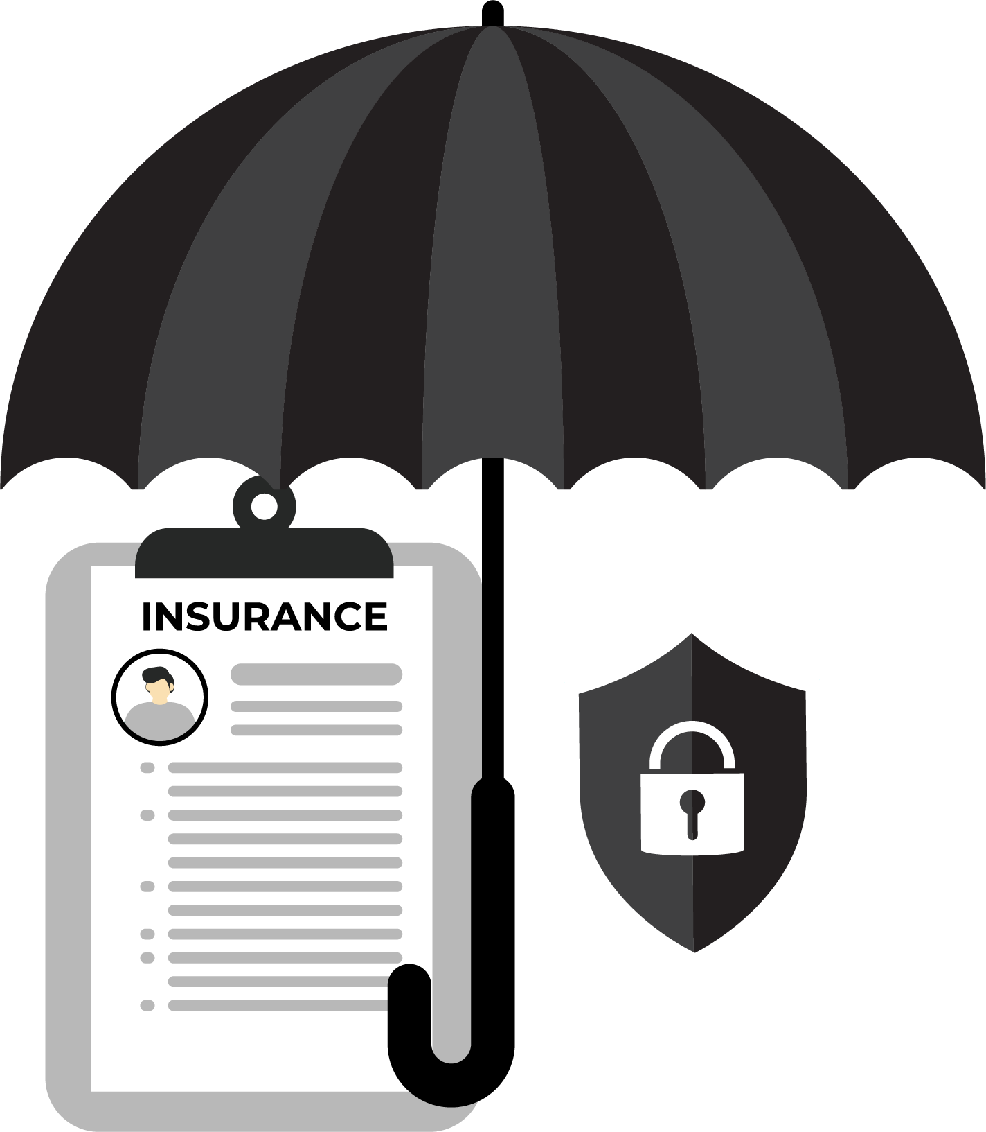
Q15
What cyber liability and errors and omissions insurance do you carry to protect me?
Our Answer: Here’s something to ask about: if THEY cause a problem with your network that causes you to be down for hours or days, to lose data or get hacked, who’s responsible? What if one of their technicians gets hurt at your office? Or damages your property while there?
In this litigious society we live in, you better make darn sure whomever you hire is adequately insured with both errors and omissions insurance, workers’ compensation and cyber liability – and don’t be shy about asking them to send you the policy to review!
If you get hit with ransomware due to their negligence, someone has to pay for your lost sales, the recovery costs and the interruption to your business operations. If they don’t have insurance to cover YOUR losses of business interruption, they might not be able to pay, and you’ll have to end up suing them to cover your costs. If sensitive client data is compromised, who’s responsible for paying the fines that you might incur and the lawsuits that could happen? No one is perfect, which is why you need them to carry adequate insurance.
True story: A few years ago, a company that shall not be named was slapped with several multimillion-dollar lawsuits from customers for bad behavior by their technicians. In some cases, their techs were accessing, copying and distributing personal information they gained access to on customers’ PCs and laptops brought in for repairs. In other cases, they lost a client’s laptop (and subsequently all the data on it) and tried to cover it up. Bottom line, make sure the I.T. firm you’re hiring has proper insurance to protect YOU.
Rest assured, we make it a priority to carry all the necessary insurance to protect you, including <<include specifics about the errors and omissions, workers’ comp and cyber liability insurances you carry>>. Simply ask, and we will be happy to show you a copy of our policy.
Q16
Who audits YOUR company’s cyber security protocols and when was the last time they conducted an audit?
Our Answer: Nobody should proofread their own work, and every professional I.T. consulting firm will have an independent third party reviewing and evaluating their company for airtight cyber security practices.
There are many companies that offer this service, so who they use can vary (there’s a number of good ones out there.) If they don’t have a professional cyber security auditing firm doing this for them on at least a quarterly basis, or if they tell you they get their peers to audit them, DO NOT hire them. That shows they are not taking cyber security seriously.
You can be confident in the effectiveness of our cyber security because we are audited by <<feature the name of your auditors>>, and we have just recently been audited in <<include month and year>>.
To Schedule Your FREE Assessment,
please visit www.website.com or call our office at 777-777-7777.
Page 16

Slide 17
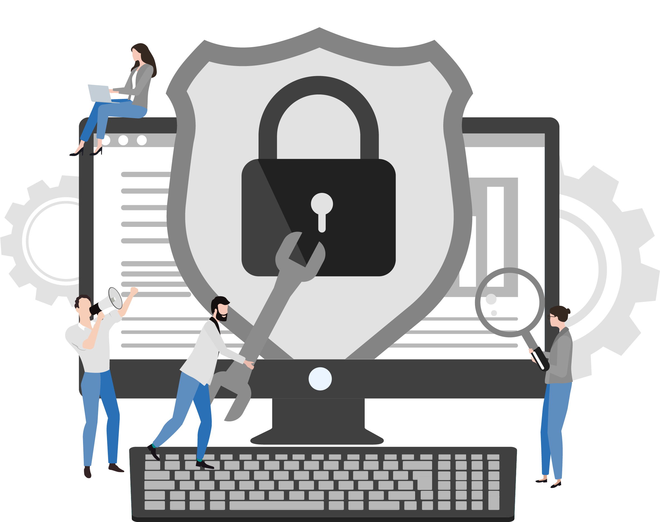
Q17
Do you have a SOC and do you run it in-house
or outsource it? If outsourced, what company
do you use?
Our Answer: A SOC (pronounced “sock”), or security operations center, is a centralized department within a company to monitor and deal with security issues pertaining to a company’s network.
What’s tricky here is that some I.T. firms have the resources and ability to run a good SOC in-house (this is the minority of outsourced I.T. firms out there.) Others cannot and outsource it because they know their limitations (not entirely a bad thing).
But the key thing to look for is that they have one. Less experienced I.T. consultants may monitor your network hardware, such as servers and workstations, for uptime and patches, but they might not provide security monitoring. This is particularly important if you host sensitive data (financial information, medical records, credit cards, etc.) and fall under regulatory compliance for data protection.
Rest assured, we do have <<an in-house or outsourced SOC>> to provide proactive security monitoring for our clients to better prevent a network violation or data breach.
Backups And Disaster Recovery:
Q18
Can you provide a timeline of how long it will take to get my network back up and running in the event of a disaster?
Our Answer: There are two aspects to backing up your data that most business owners aren’t aware of. The first is “fail over” and the other is “fail back.” For example, if you get a flat tire, you would fail over by putting on the spare tire to get to a service station where you can fail back to a new or repaired tire.
If you were to have a disaster that wiped out your data and network – be it a ransomware attack or natural disaster – you want to make sure you have a fail-over solution in place so your employees could continue to work with as little interruption as possible. This fail-over should be in the cloud and locked down separately to avoid ransomware from infecting the backups as well as the physical servers and workstations.
But, at some point, you need to fail back to your on-premise network, and that’s a process that could take days or even weeks. If the backups aren’t done correctly, you might not be able to get it back at all.
So, one of the key areas you want to discuss with your next I.T. consultant or firm is how they handle both data backup AND disaster recovery. They should have a plan in place and be able to explain the process for the emergency fail-over as well as the process for restoring your network and data with a timeline.
In this day and age, regardless of natural disaster, equipment failure or any other issue, your business should ALWAYS be able to be operational with its data within six to eight hours or less, and critical operations should be failed over immediately.
We understand how important your data is and how getting your team up and running quickly is essential to your business success. Therefore, in the event of any disaster, we can confidently get your network back up and running in <<XX hours>> or less.
Page 17

Slide 18
Q19
Do you INSIST on doing periodic test restores of my backups to make sure the data is not corrupt and could be restored in the event of a disaster?
Our Answer: A great I.T. consultant will place eyes on your backup systems every single day to ensure that backups are actually occurring, and without failures. However, in addition to this, your I.T. company should perform a monthly randomized “fire drill” test restore of some of your files from backups to make sure your data CAN be recovered in the event of an emergency. After all, the WORST time to “test” a backup is when you desperately need it.
If you don’t feel comfortable asking your current I.T. company to test your backup OR if you have
concerns and want to see proof yourself, just conduct this little test: Copy three unimportant files onto a thumb drive (so you don’t lose them) and delete them from your server. Make sure one was newly created that same day, one was created a week earlier and the last a month earlier. Then call your I.T. company and let them know you’ve lost three important documents and need them restored from backups as soon as possible. They should be able to do this easily and quickly. If not, you have a problem that needs to be addressed immediately!
Verifying your backups daily and testing them on a regular basis is a cornerstone of a successful overall I.T. strategy. These are the lengths we go to for all our clients, including multiple random “fire drill” test restores to ensure ALL your files are safe because they are always backed up.
<<Change this as you see fit.>> TIP: Ask your I.T. provider about the “3-2-2” rule of backups, which has evolved from the “3-2-1” rule. The 3-2-1 rule is that you should have three copies of your data: your working copy, plus two additional copies on different media (tape and cloud), with at least one being off-site for recovery. That rule was developed when tape backups were necessary because cloud backups hadn’t evolved to where they are today. Today, there are more sophisticated cloud backups and BDR (backup and disaster recovery) devices. Therefore, we recommend three copies of your data…<<fill in with your recommendations>>.
To Schedule Your FREE Assessment,
please visit www.website.com
or call our office at 777-777-7777.
Page 18

Slide 19
If I were to experience a location disaster, pandemic shutdown or other disaster that prevented me from being in the office, how would you enable me and my employees to work from a remote location?
Q20
Our Answer: If Covid taught us anything, it’s that work-interrupting disasters CAN and DO happen when you least expect them. Fires, floods, hurricanes and tornadoes can wipe out an entire building or location. Covid forced everyone into lockdown, and it could happen again.
We could experience a terrorist attack, civil unrest or riots that could shut down entire cities and streets, making it physically impossible to get into a building. Who knows what could be coming down the pike? Hopefully NONE of this will happen, but sadly it could.
That’s why you want to ask your prospective I.T. consultant how quickly they were able to get their clients working remotely (and securely) when Covid shut everything down. Ask to talk to a few of their clients about how the process went.
Here’s how we handled our clients’ needs when it seemed everyone needed to work remotely, get laptops and implement security measures almost overnight. <<Share your story about how you “saved the day” for your customers during a time of crisis and uncertainty.>>
Q21
Show me your process and documentation for onboarding me as a new client.
Our Answer: The reason for asking this question is to see if they HAVE SOMETHING in place. A plan, a procedure, a process. Don’t take their word for it. Ask to SEE it in writing. What’s important here is that they can produce some type of process. Further, they should be able to explain how their process works.
One thing you will need to discuss in detail is how they are going to take over from the current I.T. company – particularly if the current company is hostile. It’s disturbing to me how many I.T. companies or people will become bitter and resentful over being fired and will do things to screw up your security and create problems for the new company as a childish way of getting revenge. (Sadly, it’s more common than you think.) A good I.T. company will have a process in place for handling this.
If you consider us as your next I.T. services firm, we will gladly share our new client onboarding process and documentation. I think you’ll be impressed.
To Schedule Your FREE Assessment,
please visit www.website.com
or call our office at 777-777-7777.
Page 19

Slide 20
Other Things To Notice And Look Out For:
Are they good at answering your questions in terms you can understand and not in arrogant, confusing “geek-speak”?
Good I.T. companies won’t confuse you with techno-mumbo-jumbo, and they certainly shouldn’t make you feel stupid for asking questions. All great consultants have the “heart of a teacher” and will take time to answer your questions and explain everything in simple terms. As you interact with them in the evaluation process, watch for this.
Our technicians are trained to take time to answer your questions and explain everything in simple terms. Just look at what <<this one client/these clients>> had to say:
“
<<Insert your own testimonial>> WOW! That is all I can say about Robin and the team at Nashville Computers. It’s so nice to know that my entire network is handled so I can focus on running my business. I’ve worked with a number of other computer consultants in the past and no one can touch their level of service or expertise.
– Joe Schmo, President, WhackAMole Industries
”
Do they and their technicians present themselves as true professionals when they are in your office? Do they dress professionally and show up on time?
If you’d be embarrassed if YOUR clients saw your I.T. consultant behind your desk, that should be a big red flag. How you do anything is how you do everything, so if they cannot show up on time for appointments, are sloppy with paperwork, show up unprepared, forget your requests and seem disorganized in the meeting, how can you expect them to be 100% on point with your I.T.? You can’t. Look for someone else.
Our technicians are true professionals who you would be proud to have in your office. They dress professionally and show up on time, and if they cannot be there on time (for some odd, unforeseen reason), we always notify the client immediately. We believe these are minimum requirements for delivering a professional service.
To Schedule Your FREE Assessment,
please visit www.website.com or call our office at 777-777-7777.
Page 20

Slide 21
Do they have expertise in helping clients similar to you?
<<Use this answer to describe the type of client you support, whether that’s a vertical (like dentists) or a size (small business, enterprise accounts with sophisticated cyberneeds).>>
Do they understand how your business operates the line-of-business applications you depend on? Are they familiar with how you communicate, get paid, service your clients or patients and run your business? We have several <<medical, accounting, attorney, etc.>> clients. The reason we work well with them is because <<give one or two examples of how you work well in that industry>>. Here’s what <<one client/a few of our clients>> had to say:
<<Insert one to three good testimonials from your clients that meet the above criteria.>>
“
WOW! That is all I can say about Robin and the team at Nashville Computers. It’s so nice to know that my entire network is handled so I can focus on running my business. I’ve worked with a number of other computer consultants in the past and no one can touch their level of service or expertise.
– Joe Schmo, President, WhackAMole Industries
”
“
Before hiring Nashville Computers, our network would go down regularly, run slow, and even run into the occasional virus. Since signing up with their network maintenance plan, we haven’t had one single issue. I’m VERY glad we hired these guys to support our network.
– Maury Owner, BigToe Construction
”
“
Robin, you truly exceeded my expectations and I cannot thank you enough for all of your hard work and diligence in making sure everything went according to plan. Please do not hesitate to use me as a reference; I plan on recommending your services to all of my clients and friends.”
– Mary Contrary, President, RealEstateRUs
”
Page 21

Slide 22
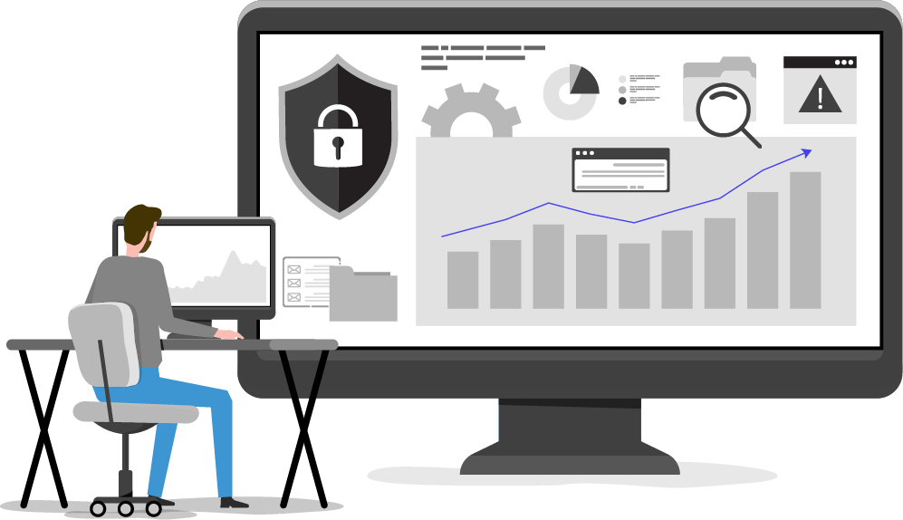
A Final Word And Free Offer To Engage With Us
I hope you have found this guide helpful in shedding some light on what to look for when hiring a professional firm to outsource your I.T. support. As I stated in the opening of this report, my purpose in providing this information is to help you make an informed decision and avoid getting burned by incompetent or unethical firms luring you in with cheap prices.
The next step is simple: call my office at <<XXX-XXX-XXXX>> and reference this letter to schedule a brief 10- to 15-minute initial consultation.
On this call we can discuss your unique situation and any concerns you have and, of course, answer any questions you have about us. If you feel comfortable moving ahead, we’ll schedule a convenient time to conduct our proprietary <<XX-Point I.T. Systems Assessment>>.
This Assessment can be conducted 100% remotely with or without your current I.T. company or department knowing (we can give you the full details on our initial consultation call). At the end of the Assessment, you’ll know:
Where you are overpaying (or getting underserved) for the services and support you are currently getting from your current I.T. company or team.
Whether or not your systems and data are truly secured from hackers and ransomware, and where you are partially or totally exposed.
If your data is actually being backed up in a manner that would allow you to recover it quickly in the event of an emergency or ransomware attack.
Where you are unknowingly violating <<insert specific data breach or compliance regulations specific to care groups here>>.
How you could lower the overall costs of I.T. while improving communication, security and performance, as well as the productivity of your employees.
Fresh eyes see things that others cannot – so, at a minimum, our free Assessment is a completely cost- and risk-free way to get a credible third-party validation of the security, stability and efficiency of your I.T. systems.
To Schedule Your FREE Assessment,
please visit www.website.com
or call our office at 777-777-7777.
With appreciation,
<<Signature>>
<<Your Name>>, <<Title>>
<<Company>>
Page 22

Slide 23
See What Other Business Owners Are Saying:
<Title Of Testimonial With Results>>
Outline the story of the testimonial here. Remember, all testimonials should either validate a claim you are making and/or overcome an objection and should be directly related to your cloud solution.
– Joe Schmo, President, WhackAMole Industries
<Title Of Testimonial With Results>>
Outline the story of the testimonial here. Remember, all testimonials should either validate a claim you are making and/or overcome an objection and should be directly related to your cloud solution.
– Joe Schmo, President, WhackAMole Industries
<Title Of Testimonial With Results>>
Outline the story of the testimonial here. Remember, all testimonials should either validate a claim you are making and/or overcome an objection and should be directly related to your cloud solution.
– Joe Schmo, President, WhackAMole Industries
<Title Of Testimonial With Results>>
Outline the story of the testimonial here. Remember, all testimonials should either validate a claim you are making and/or overcome an objection and should be directly related to your cloud solution.
– Joe Schmo, President, WhackAMole Industries
Page 23

Slide 24
A Final Word And Free Offer To Engage With Us
1
We Respond Within 5 Minutes Or Less. The average amount of time it takes for one of our clients to get on the phone with a technician who can start working on resolving their problem is 3.5 minutes. We know you’re busy and we have made a sincere commitment to making sure your computer problems get fixed FAST. And since most repairs can be done remotely using our secure management tools, you don’t have to wait around for a technician to show up.
No Geek-Speak. You deserve to get answers to your questions in PLAIN ENGLISH, not in confusing technical terms. Our technicians will also not talk down to you or make you feel stupid because you don’t understand how all this “technology” works. That’s our job!
100% No-Small-Print Satisfaction Guarantee. Quite simply, if you are not happy with our work, we’ll do whatever it takes to make it right to YOUR standards without charging you for it. And if we can’t make it right, the service is free.
All Projects Are Completed On Time And On Budget. When you hire us to complete a project for you, we won’t nickel-and-dime you with unforeseen or unexpected charges or delays. We guarantee to deliver precisely what we promised to deliver, on time and on budget, with no excuses.
Lower Costs, Waste And Complexity With Cloud Solutions. By utilizing cloud computing and other advanced technologies, we can eliminate the cost, complexity, and problems of managing your own in-house server while giving you more freedom, lowered costs, tighter security and instant disaster recovery.
We Won’t Hold You Hostage. Many I.T. companies do NOT provide their clients with simple and easy-to-understand documentation that outlines key network resources, passwords, licenses, etc. By keeping that to themselves, I.T. companies hold their clients “hostage” to scare them away from hiring someone else. This is both unethical and unprofessional. As a client of ours, we’ll provide you with full, written documentation of your network and all the resources, software licenses, passwords, hardware, etc., in simple terms so YOU can understand it. We keep our clients by delivering exceptional service – not by keeping them in the dark.
Peace Of Mind. Because we monitor all our clients’ networks 24/7/365, you never have to worry that a virus has spread, a hacker has broken in or a backup has failed to perform. We watch over your entire network, taking the management and hassle of maintaining it off your hands. This frees you to focus on your customers and running your business, not on your I.T. systems, security and backups.
2
3
4
5
6
7
To Schedule Your FREE Assessment,
please visit www.website.com or call our office at 777-777-7777.

